Slide 1


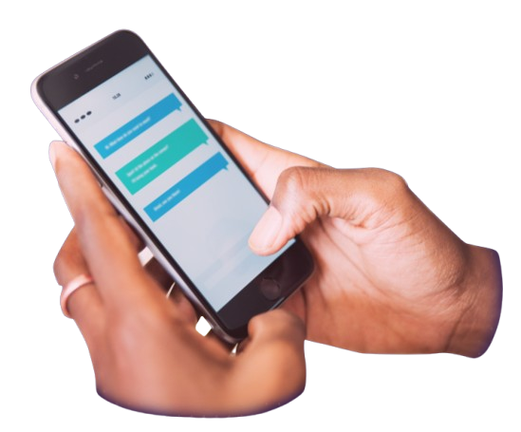
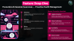
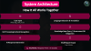

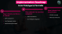

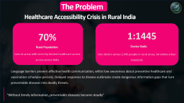
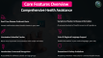
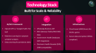
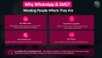

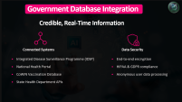
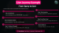


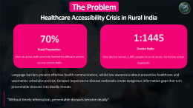

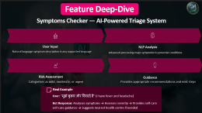

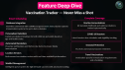

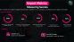



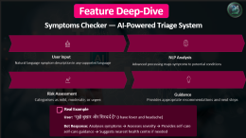

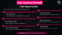
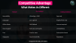

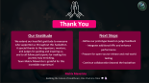










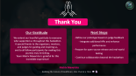

AI-Driven Public Health Chatbot for Disease Awareness
Bridging the Healthcare Gap in Rural & Semi-Urban India
Team:
Matrix Mavericks

Slide 2
The Problem
Healthcare Accessibility Crisis in Rural India
70%
1:1445
Rural Population
Doctor Ratio
Lives in areas with severely limited healthcare access across India
One doctor serves 1,445 people in rural areas, far below urban standards
Language barriers prevent effective health communication, whilst low awareness about preventive healthcare and vaccination schedules persists. Delayed responses to disease outbreaks create dangerous information gaps that turn preventable diseases into deadly threats.
"Without timely information, preventable diseases become deadly"

Slide 3
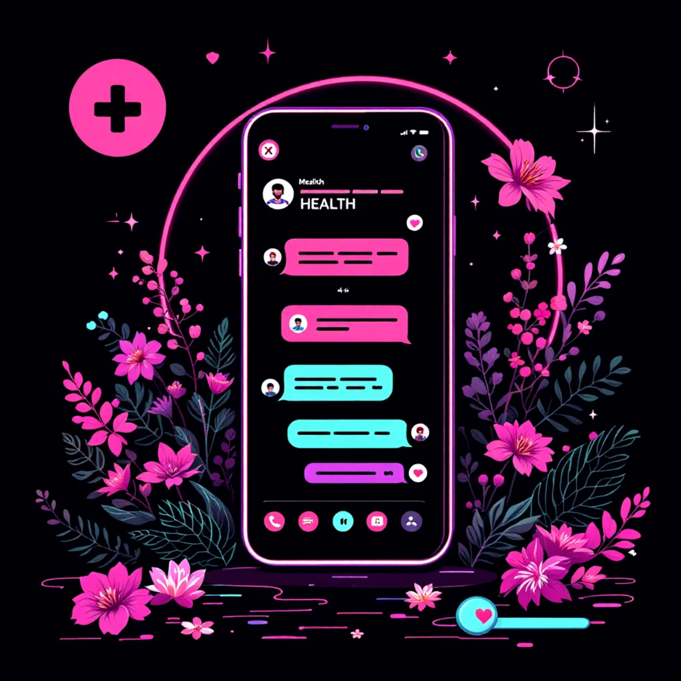
Our Solution
Meet Your AI Health Companion
A multilingual, AI-powered chatbot accessible via WhatsApp & SMS that delivers comprehensive health support directly to communities who need it most.
Key Capabilities:
Provides real-time outbreak alerts for rapid response
Educates communities about diseases and prevention methods
Tracks vaccination schedules with intelligent reminders
Offers symptom checking in regional languages
Works with voice and handwritten commands

Slide 4





Why WhatsApp & SMS?
Meeting People Where They Are
487 Million Users
Basic Phone Compatible
WhatsApp's massive reach across India in 2024
ensures unprecedented accessibility
Works on simple devices with minimal internet
connectivity requirements
Zero Learning Curve
SMS Backup
Familiar interface everyone already knows and trusts
Ensures delivery even in zero-connectivity areas
Accessibility First, Technology Second — Our platform prioritises reaching people over showcasing complex technology, ensuring cost-effective solutions for rural populations.

Slide 5






Core Features Overview
Comprehensive Health Assistance
Real-Time Disease Outbreak Alerts
Symptoms Checker & Disease Information
Instant notifications about health threats in your area
AI-powered analysis of health concerns with guidance
Vaccination Schedule Tracker
Voice & Regional Language Support
Never miss important immunisations with smart reminders
Health information in your native language, your way
Handwritten Command Recognition
Precautions & Safety Guidelines
Accessibility for all literacy levels and age groups
Proactive prevention measures for common health threats

Slide 6





Feature Deep-Dive
Symptoms Checker — AI-Powered Triage System
User Input
NLP Analysis
Natural language symptom description in any supported language
Advanced processing maps symptoms to potential conditions
Risk Assessment
Guidance
Categorises as mild, moderate, or urgent
Provides appropriate recommendations and next steps
Real Example
User: "मुझे बुखार और सिरदर्द है" (I have fever and headache)
Bot Response: Analyses symptoms → Assesses severity → Provides self-care guidance → Suggests nearest health centre if needed

Slide 7
Feature Deep-Dive
Vaccination Tracker — Never Miss a Shot
Smart Scheduling
Complete Coverage
Database Integration
Routine Immunisations
Seamless connection with CoWIN and government immunisation systems for up-to-date schedules
All standard childhood and adult vaccinations
tracked systematically
Personalised Calendars
COVID-19 Boosters
Custom vaccination timelines for both children and adults based on
age and health status
Latest booster dose schedules and eligibility tracking
Automated Reminders
Proactive notifications sent before due dates to ensure timely
immunization
Seasonal Protection
Flu shots and seasonal vaccine reminders
Location Services
Travel Vaccinations
Finds nearest vaccination centres with real-time availability information
Destination-specific immunization requirements
and scheduling
Waitlist Management
Intelligent queue system for high-demand vaccines with automatic booking

Slide 8
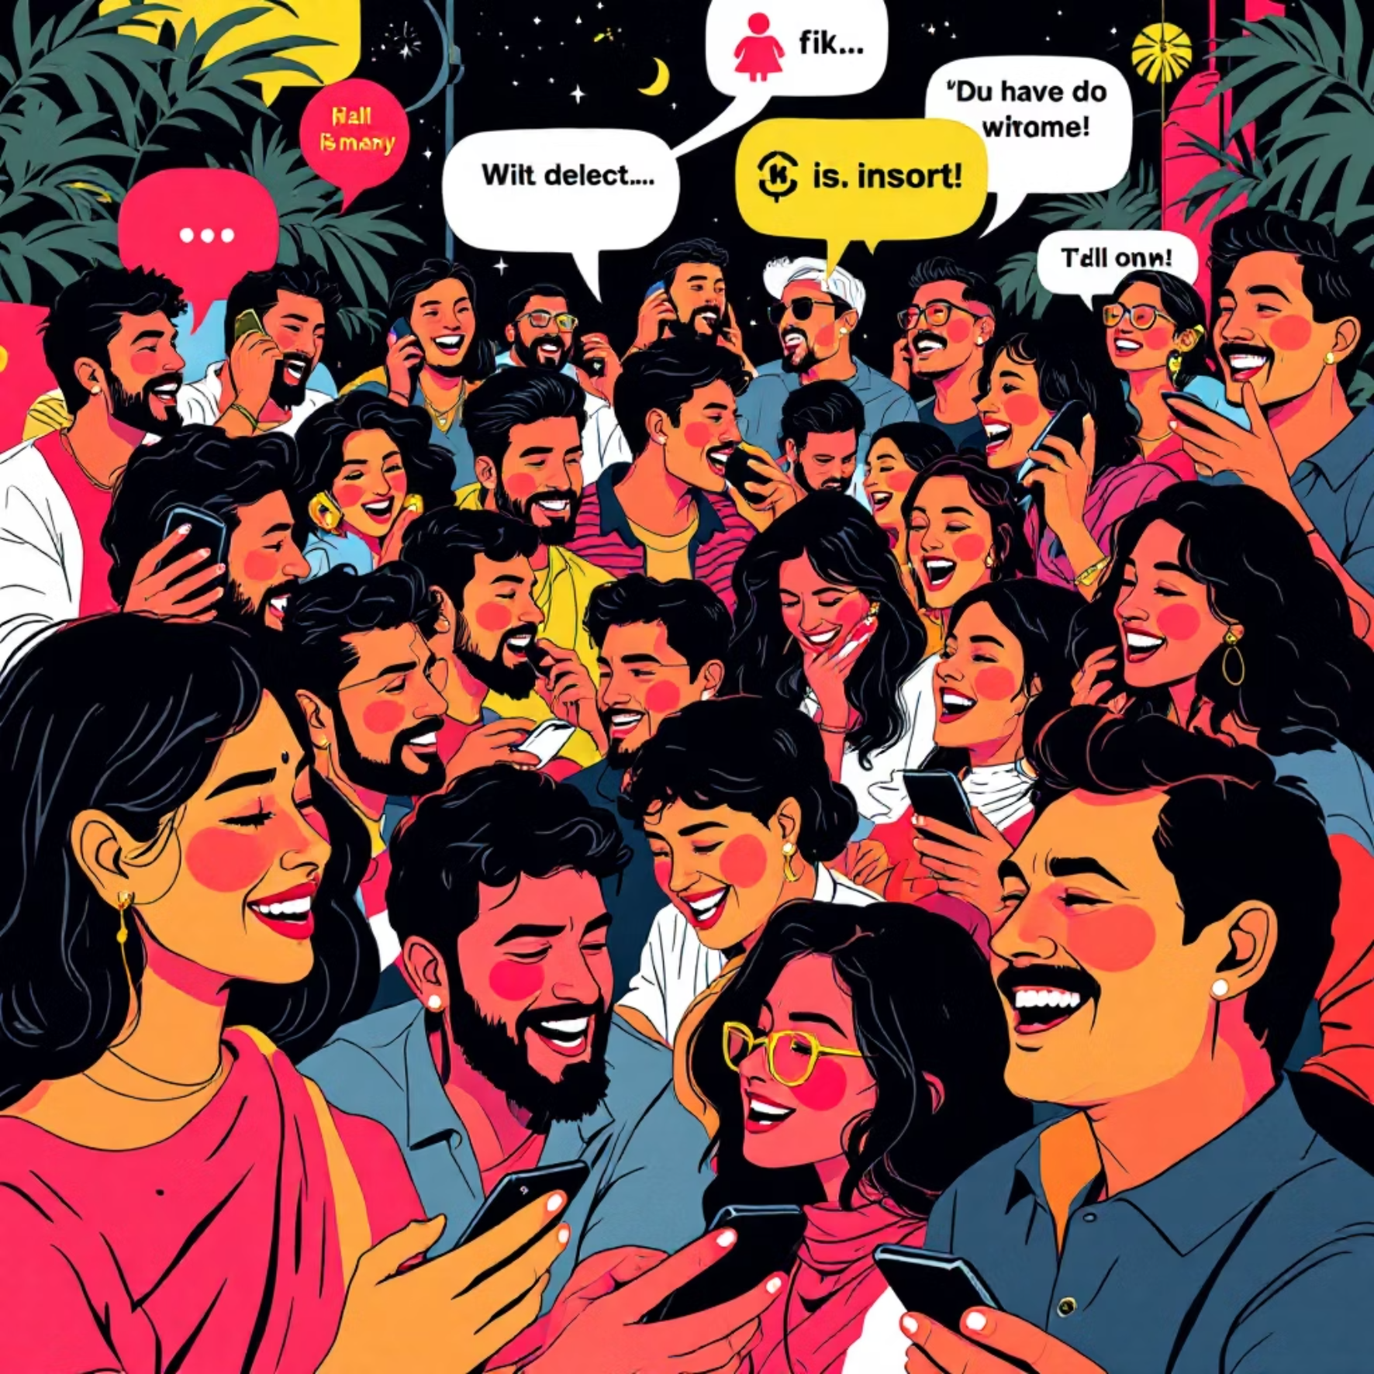
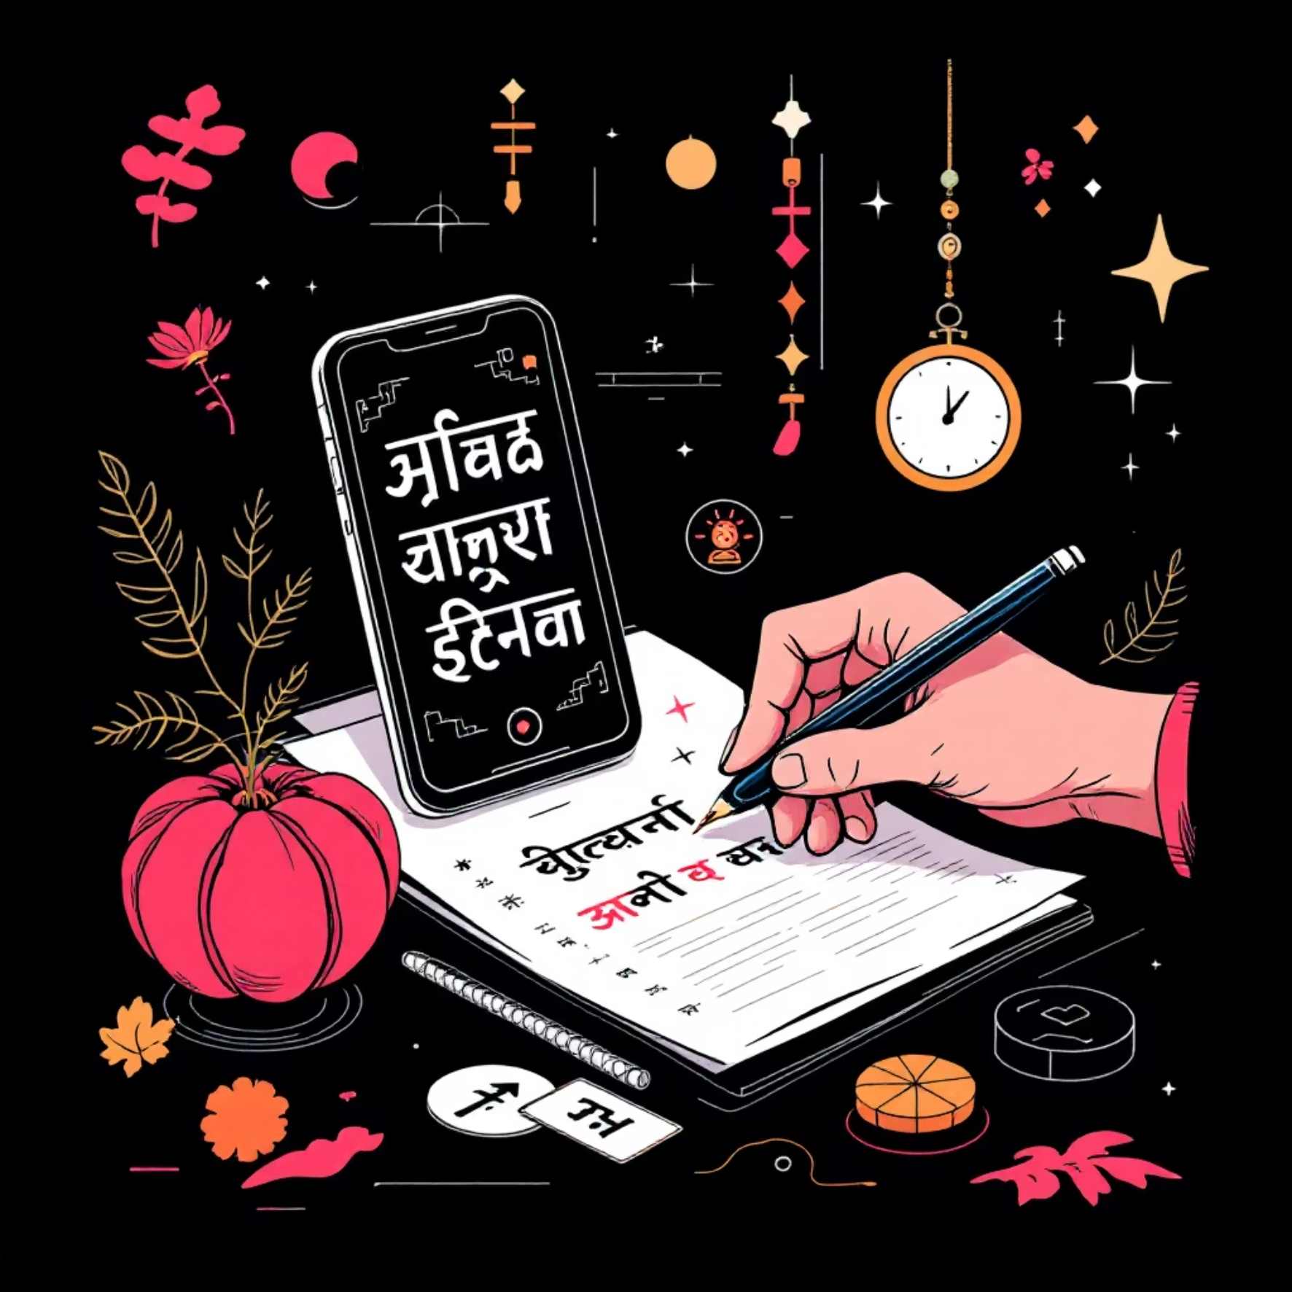
Feature Deep-Dive
Multilingual Support — Breaking Language Barriers
Voice Recognition
Handwritten Recognition
10+ regional languages including Hindi, Tamil, Telugu, Bengali, Marathi,
Gujarati, Kannada, Malayalam, Punjabi, and Odia
OCR technology accurately processes handwritten queries
in multiple scripts
Real-time language detection automatically identifies the user's language
Regional script support for Devanagari, Tamil, Bengali, and
other writing systems
Voice-to-text conversion ensures accessibility for users with limited literacy
Text-to-speech responses deliver answers in natural, spoken language
Elderly-friendly interface accommodates users uncomfortable
with typing
"Health information in YOUR language, YOUR way"

Slide 9
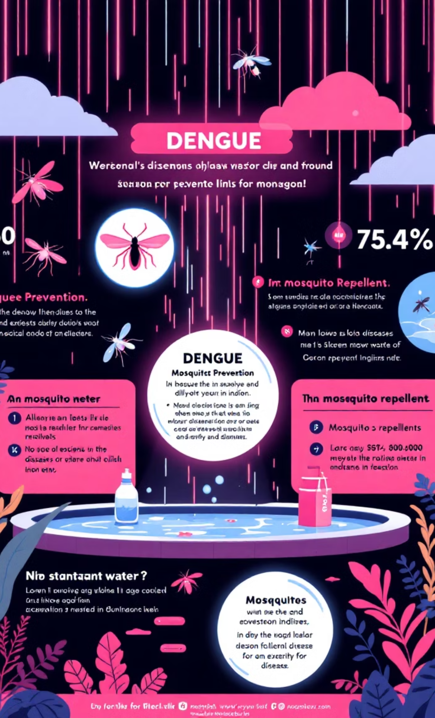




Feature Deep-Dive
Precautions & Seasonal Awareness — Proactive Health Management
Disease Prevention Essentials
1
Monsoon
Dengue, malaria, and leptospirosis alerts with
prevention strategies
Hygiene Practices
Evidence-based guidance for preventing
common illnesses through proper sanitation
2
Summer
Water Purification
Heat stroke prevention, dehydration warnings,
and cooling tips
Simple, effective methods for ensuring safe
drinking water in any setting
3
Winter
Food Safety
Flu, pneumonia awareness, and respiratory
health guidance
Guidelines for proper food handling,
storage, and preparation to prevent illness
Vector Control
Practical measures to prevent mosquito-
borne and other vector-transmitted diseases

Slide 10



Technology Stack
Built for Scale & Reliability
AI/ML Framework
Integration
Infrastructure
OpenAI GPT-4 / Google PaLM 2 for NLP
WhatsApp Business API
Cloud-based (AWS/Azure) for 99.9% uptime
SMS Gateway (Twilio/AWS SNS)
Machine Learning for symptom analysis
Secure data encryption (HIPAA-compliant)
Government Health Databases (API integration)
Deep Learning for predictive alerts
Electronic Health Records (EHR) compatibility

Slide 11







System Architecture
How It All Works Together
User Input
Language Detection & Translation
WhatsApp, SMS, Voice
NLP Processing & Intent Recognition
Knowledge Base Query / Government DB
Integration
AI Response Generation
Multilingual Output
Text & Voice
Key Metric: Response Time: < 3 seconds

Slide 12


Government Database Integration
Credible, Real-Time Information
Connected Systems
Data Security
Integrated Disease Surveillance Programme (IDSP)
End-to-end encryption
National Health Portal
HIPAA & GDPR compliance
CoWIN Vaccination Database
Anonymous user data processing
State Health Department APIs

Slide 13






User Journey Example
From Query to Care
A real scenario: Farmer in rural Maharashtra experiences fever
Step 2: Bot Interaction
Step 1: Initial Query
Bot detects Marathi → Asks follow-up questions
Opens WhatsApp → Sends "मला ताप आहे" (I have fever)
Step 4: Local Data Check
Step 3: Symptom Analysis
Checks local outbreak data → Dengue alert in area!
Analyzes symptoms → Identifies possible dengue
Step 6: Follow-up
Step 5: Guidance & Support
Schedules follow-up check-in in 24 hours
Provides: Prevention tips, nearest testing center, home care
Key Metric: Total time: 2 minutes | Could save a life

Slide 14







Impact Metrics
Measuring Success
Our initiatives aim to deliver tangible improvements in healthcare access, awareness, and efficiency across target communities.
Expected Outcomes
80%
50%
35%
70%
20%
Accuracy in answering
health queries
Increase in health awareness
in target communities
Reduction in unnecessary
hospital visits
Faster outbreak
response time
Improvement in
vaccination adherence
Scalability
500,000+ Users
Pan-India Coverage
Support per deployment
Expandable to reach all regions

Slide 15
Competitive Advantage
What Makes Us Different
Feature
Our Solution
Existing Solutions
Accessibility
WhatsApp + SMS
App-only
Languages
10+ regional
English/Hindi only
Offline Mode
SMS fallback
Internet required
Voice Support
Full voice commands
Limited/None
Cost
Free for users
Subscription-based
Integration
Government DBs
Standalone
Designed FOR India, BY Indians

Slide 16






Social Impact
Transforming Rural Healthcare
Our solution is designed to create a profound social impact, touching millions of lives and aligning with critical global development goals.
Lives Changed
Empowering Health Knowledge
Saving Mothers & Children
Empowering 900 million rural Indians with accessible
health information and knowledge.
Reducing maternal & child mortality through
timely vaccinations and health guidance.
Preventing Epidemic Spread
Combating Misinformation
Preventing epidemic spread by providing rapid
information in vulnerable communities.
Breaking the cycle of health misinformation with reliable,
verified content.
UN Sustainable Development Goals
Goal 3: Good Health & Well-being
Goal 10: Reduced Inequalities
Ensuring healthy lives and promoting well-being
for all at all ages.
Reducing inequality within and among countries,
especially in healthcare access.

Slide 17



Implementation Roadmap
From Prototype to Pan-India
Phase 3 (Months 7-12): National rollout
Phase 2 (Months 4-6): State-level deployment
Phase 1 (Months 1-3): Pilot in 2 districts
All-India coverage
Scale to 50 districts
Advanced AI features
MVP development
User feedback integration
Local language training
Government partnerships

Slide 18
Challenges & Solutions
Addressing the Real Issues
Challenge
Our Solution
Low smartphone penetration
SMS fallback system
Internet connectivity
Offline mode with periodic sync
Low literacy rates
Voice commands + visual aids
Data privacy concerns
End-to-end encryption + anonymization
Language diversity
Continuous ML training on regional dialects
Misinformation
Government-verified knowledge base only

Slide 19





Future Enhancements
Vision 2.0
Image-based diagnosis
Telemedicine integration
For skin conditions and rashes.
Seamless connection with doctors.
IoT device connectivity
Predictive health analytics
BP monitors, glucose meters, and more.
Proactive insights for better health outcomes.
Global Expansion
Genetic testing integration
Reaching other developing nations.
For personalized care plans.

Slide 20

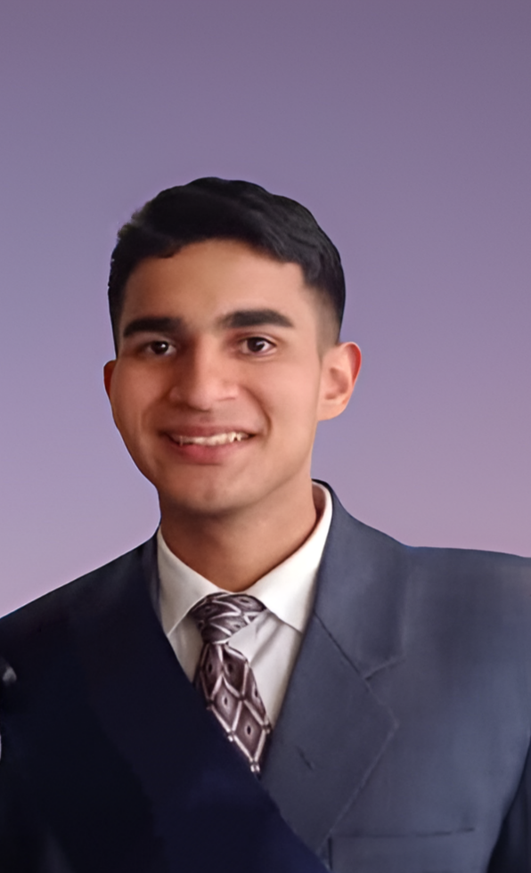

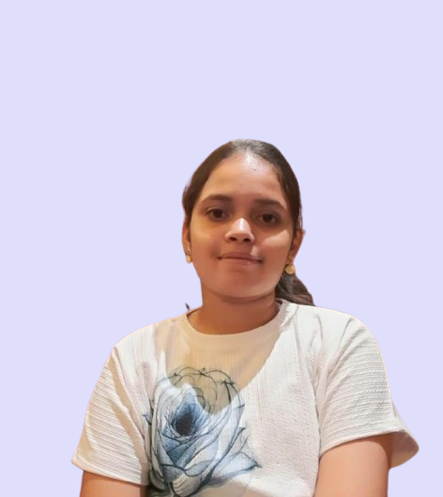
Team Introduction
Matrix Mavericks
Parth Ajmera
Yashvardhan Dobhal
Aashu Joshi
Anshika Bijalwan
B.Tech Computer Science
Doon University
B.Tech Computer Science
Doon University
B.Tech Computer Science
Doon University
B.Tech Computer Science
Doon University
Passionate about leveraging technology for social impact

Slide 21

Call to Action
Join Us in This Mission
We Need:
Partnership with State Health Departments
Pilot district for initial deployment
Technical mentorship for scaling
Funding for infrastructure
Contact:
Email: Team.matrixmavericks@gmail.com
"Health is a right, not a privilege. Let's make it accessible to all."

Slide 22
Thank You
Our Gratitude
Next Steps
We extend our heartfelt gratitude to everyone who supported us throughout this hackathon.
A special thanks to the organizers, mentors, and judges for guiding and inspiring us,
and to all fellow participants for making this journey truly enriching.
Team Matrix Mavericks is grateful for this incredible experience!
- Refine our prototype based on judge feedback
- Integrate additional APIs and enhance performance
- Prepare for open-source release and real-world testing
- Continue collaboration beyond the hackathon
Matrix Mavericks
Building the Future of Healthcare, One Chat at a Time 💬🏥

